Slide 1
Machine learning algorithms Facebook performance metrics dataset
BY :
B.K.HEM CHARAN - 17BEC0189

Slide 2
Selecting the dataset
Here is the link to the dataset:
https://archive.ics.uci.edu/ml/datasets/Facebook+metrics
The motivation behind this dataset is this will predict how many likes a post will have based on features in dataset
Description of the Dataset:
The data is related to posts' published during the year of 2014 on the Facebook's page of a renowned cosmetics brand. This dataset contains 500 of the 790 rows and the remaining were omitted due to confidentiality issues. It includes 19 attributes in which 7 features known prior to post publication and 12 features for evaluating post impact.

Slide 3
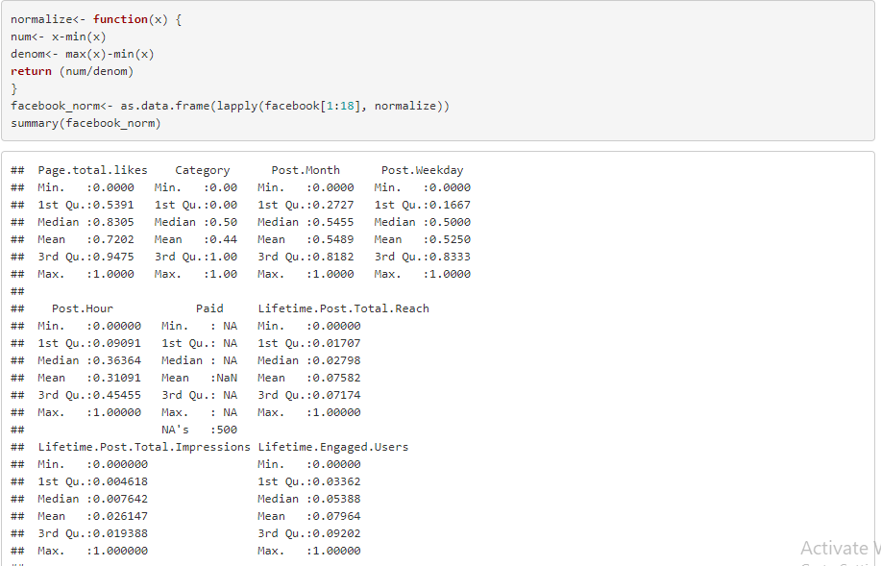
Data has to be normalised so that it can be turned into a usable format.We removed null values.
R language has been used throughout the project to test Linear and Non-Linear models on the dataset.

Slide 4
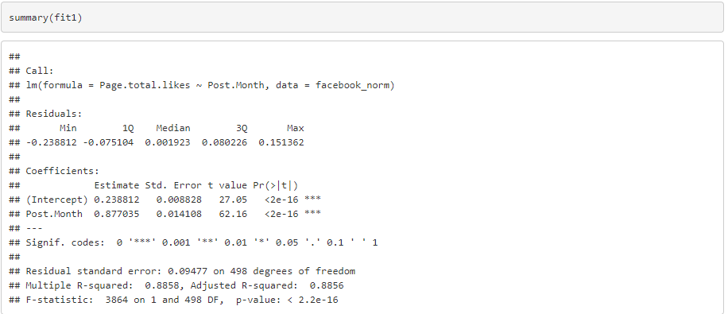
Overviews of Linear Models used
Linear Regression :
The summary of the Linear Regression gives us an idea about the important features which gives impact to the output.

Slide 5
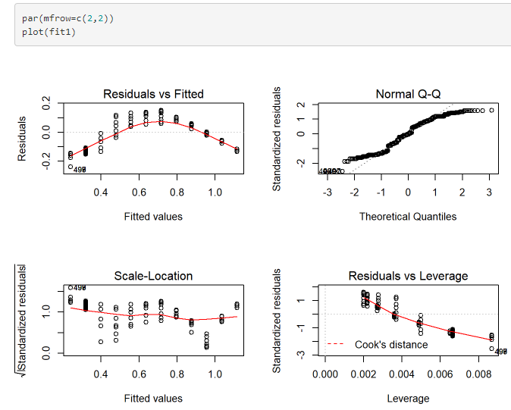
Overviews of Linear Models used
The residual error and leverage of variables can be seen in the plot below:

Slide 6
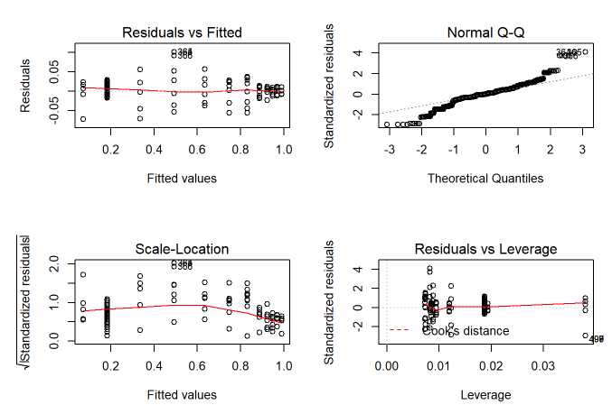
Overviews of Linear Models used
Here is a plot when we increase the degree of polynomials. Model fitting was better for higher degrees of polynomial.

Slide 7
Comparative analysis of performance of Linear models
When linear regression and multiple linear regression were compared, multiple regression proved to be a better model than linear one. As if we could see from the graphs itself it was not able to fit properly. In multiple regression,MultipleR-squared:0.8858, Adjusted R-squared: 0.8867 value also tells us that it is a better model.
Thus we infer that a model size of 3 and of higher degree polynomial gives max accuracy.
R-squared Value:-
Linear Regression | Multiple Regression
0.8856 | 0.8867

Slide 8
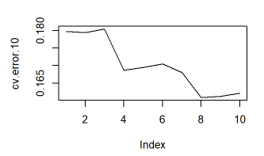
Details of Validation tests
we use 10-fold here because of its high computational speed compared to LOOCV.

Slide 9
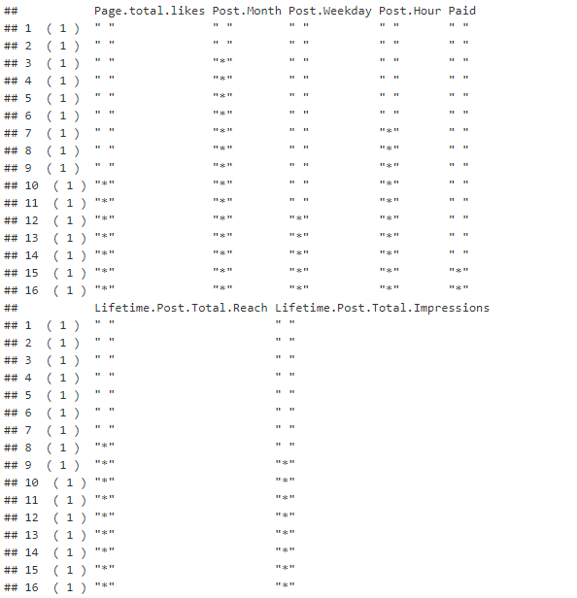
Details of methodology used for model selection and regularisation
While there many model selection methods out there, backward elimination method is being used in this project.

Slide 10
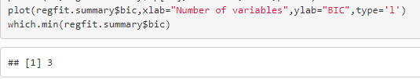
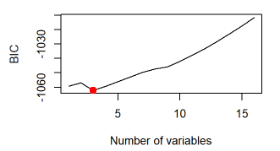
Details of methodology used for model selection and regularisation
We take the number variables which has least bic statistic.
And we can see that backward subset gives the same output that the model with 3 variables gives best fit.

Slide 11
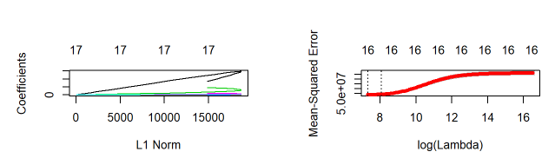
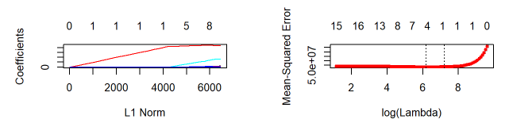
Details of methodology used for model selection and regularisation
1. Ridge Regression :
2. Lasso :

Slide 12
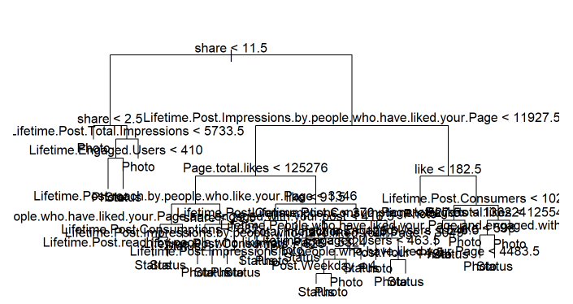
Overview of Non linear models used
1. Decision Trees :

Slide 13
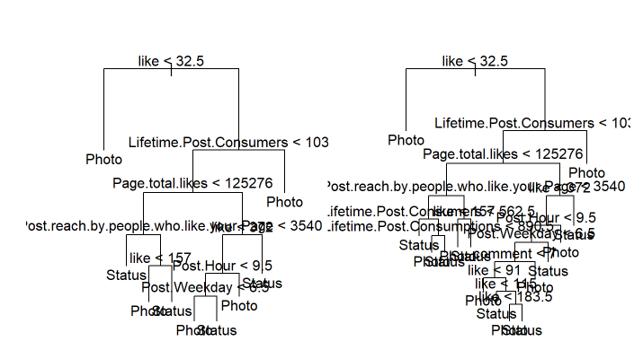
Overview of Non linear models used
The tree is bit difficult to decode but one can easily infer if the posted thing is a photo or status in facebook.
Pruning is done so that it makes the DT shallow so that it is better for visualizing.

Slide 14
Since our Facebook metrics dataset has very less attributes, we would like to change our dataset to Census Income Dataset for Non-Linear methods.
Title of Project: Census Income Dataset
Goal of the project :
The main objective here is to predict whether a person makes over 50K a year.
Link from where dataset was downloaded
https://archive.ics.uci.edu/ml/datasets/Census+Income

Slide 15



Overviews of Linear Models used
Logistic Regression :
Linear Discriminant Analysis :
Quadratic Discriminant Analysis:
From above we can infer that LDA has the least error which means this gives the most accurate prediction compared to the other two models.

Slide 16
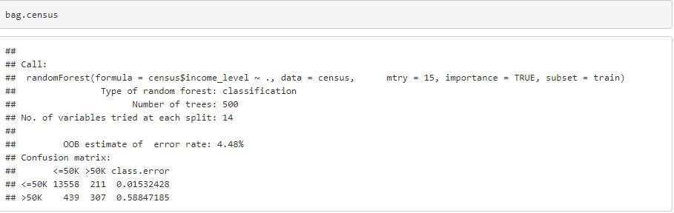
Overview of Non linear models used
2. Bagging:

Slide 17
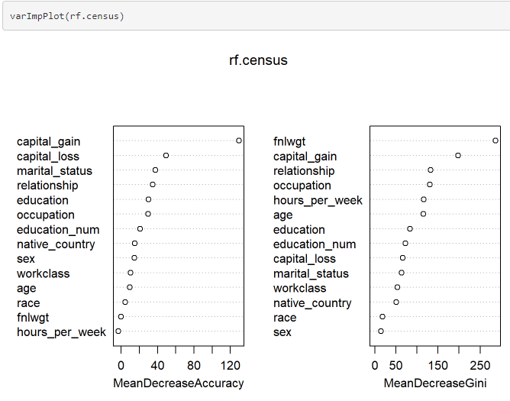
Overview of Non linear models used
3. Random Forests:

Slide 18
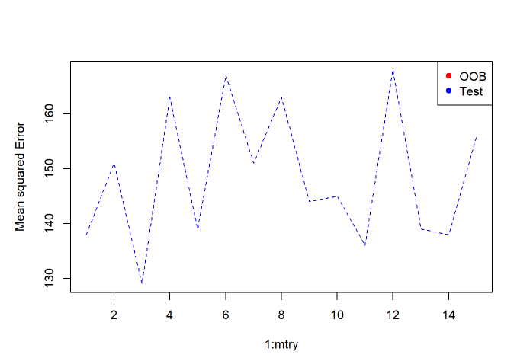
Overview of Non linear models used
We now see the plots of out of bag error(OOB) and test error. We observe that for both OOB error and test error, for mtry =3, we have least MSE

Slide 19
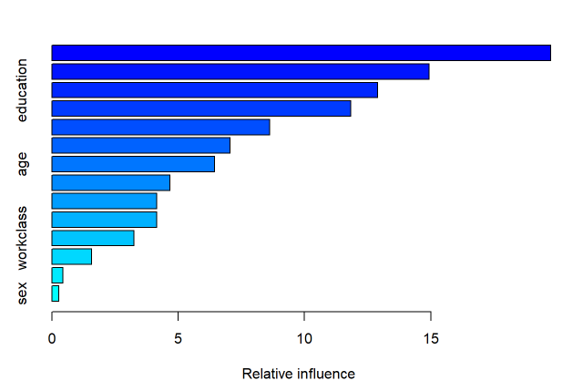
Overview of Non linear models used
4. Boosting:
Boosting gives the best method for selecting the model by giving a bar plot of the importance of each predictor.

Slide 20
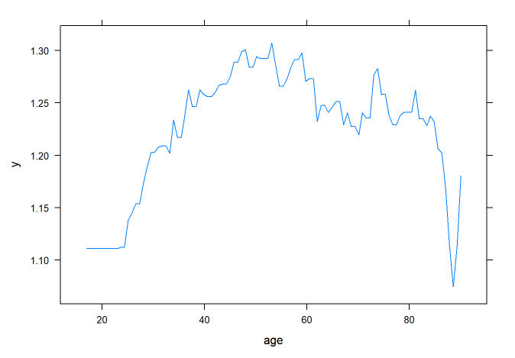
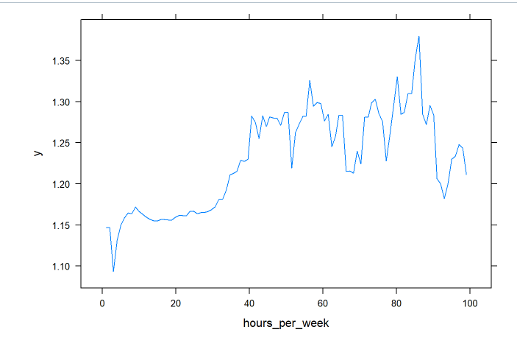
Overview of Non linear models used
Now we can see the impact of each variable individually.

Slide 21
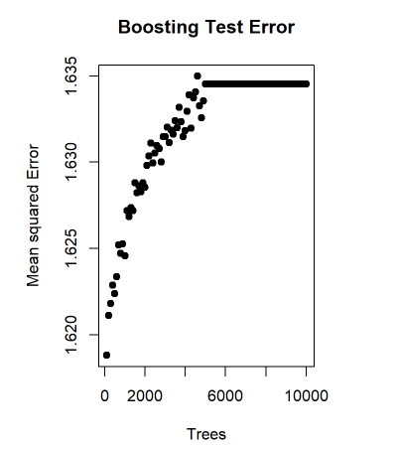
Overview of Non linear models used
We now see the boosting test error rate.

Slide 22
Comparative analysis of performance of non-Linear models
1. Bagging:
print(yhat.bag) = 254.3912
print(sqrt(yhat.bag)) = 15.94965
2. Random Forests:
print(yhat.rf) = 93.15057
print(sqrt(yhat.rf)) =9.651454
3. Boosting:
print(yhat.boost) = 155.6567
print(sqrt(boost)) =12.4762

Slide 23
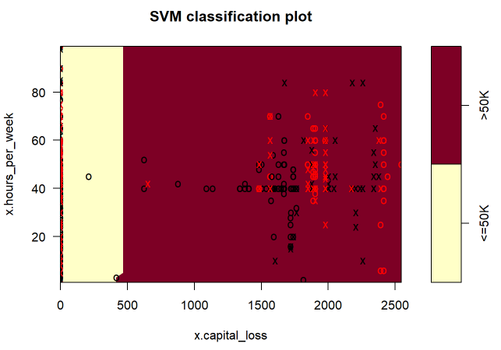
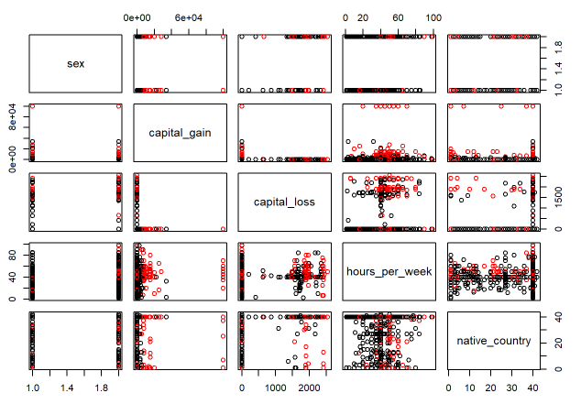
Overview of Non linear models used
5. Support Vector Machine (SVM):

Slide 24
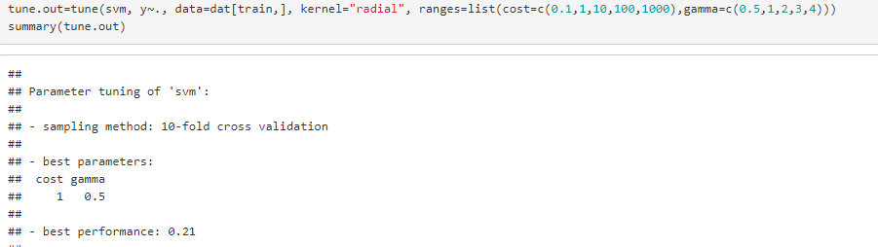
Overview of Non linear models used
When we tune SVM for different range of costs, we can see from below that when cost=1,gamma=0.5, SVM gives the best performance.
Support Vector Machine can also be used as a regression method, maintaining all the main features that characterize the algorithm (maximal margin).

Slide 25
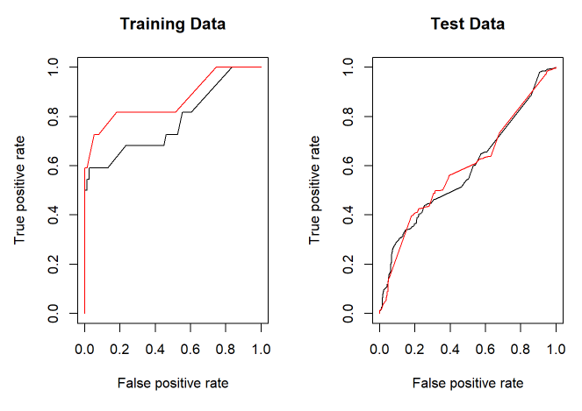
ROC curve
We here see ROC curves of training and testing data.

Slide 26
Recommendation of which model is the most suited and why
Random forest
Random forests are quite tolerant to heterogeneity in the training data. It can handle both numerical and categorical data which, does not need extensive and potentially dangerous pre-processing, such as scaling or normalization. Even the presence of strongly correlated predictors is not a problem for model construction.
By combining information from individual trees, it can estimate the importance of each predictor, thus making the model more interpretable.

Slide 27


